Slide 2
Table of Content
UJIEC
About
UJ Basic statistics
Organizational Structure
What UJIEC offer ?
Strategic Goals
Resources
Stakeholders
How we work
Challenges
CTI @ UJIEC
Activities In Numbers 2017

Slide 3
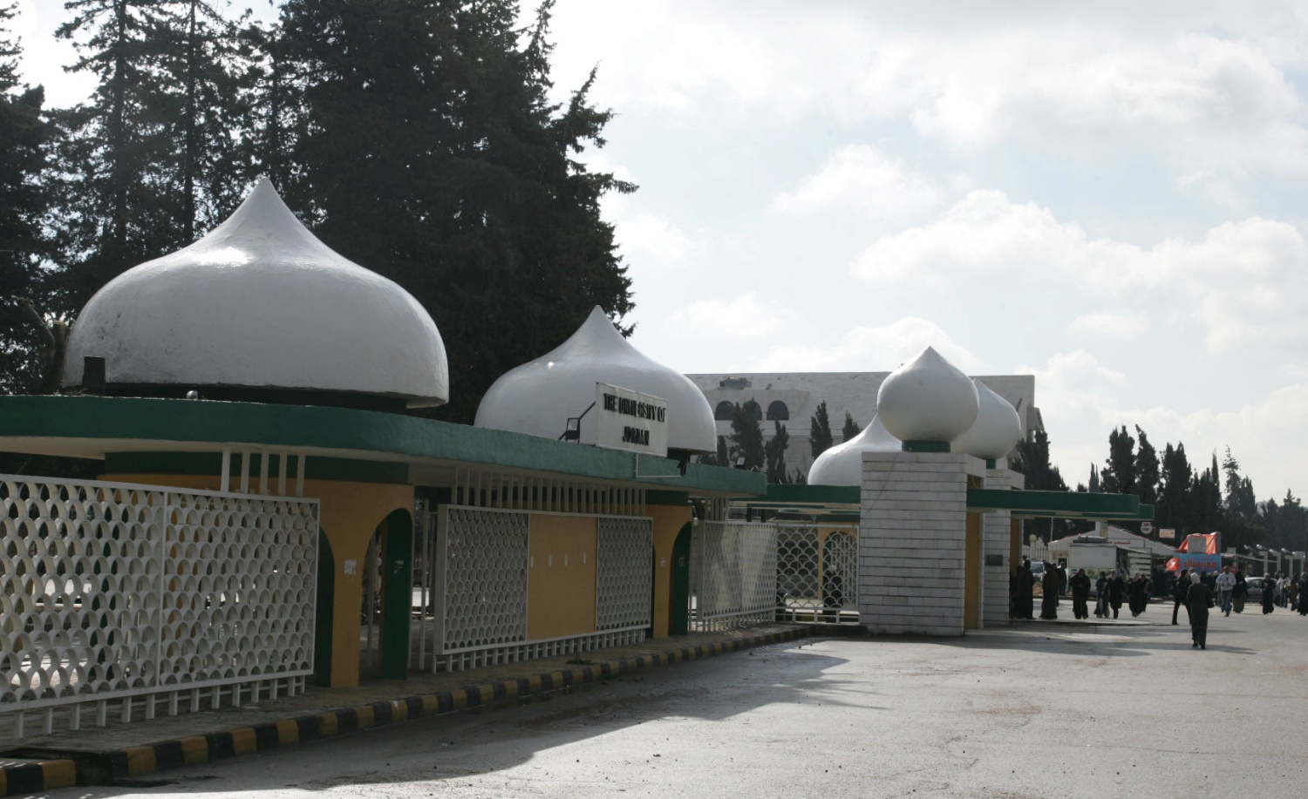
University of Jordan Innovation and Entrepreneurship Center
Dr.Ashraf Bany Mohammed
Director of UJIEC
a.bany@ju.edu.jo

Slide 4
About UJIEC
“The University of Jordan Innovation and Entrepreneurship Center was established by decree from UJ Board of Trustees in 2015.
Vision: To be a one-stop support hub for innovators and entrepreneurs @ UJ in collaboration and partnership with all stakeholder in both public and private sector.
Mission: To promote and foster innovation and entrepreneurship culture, education, training and practice to create a generation capable of making a real contribution to the economic development in Jordan
UJIEC team consist of 6 full time employees along with 15 part-time volunteers

Slide 5
University of Jordan - Basic Stat
Item | STAT
Faculty members (Full time) | 1,750
Employees | 4,441
Students | 43,774
Schools | 19
Undergraduate Programs | 150 +
Students | STAT
Undergraduate | 37254
Masters | 4441
Doctoral | 2079
Exec Ed Degree Granting | 5500+

Slide 6
UJIEC Organizational Structure
Center Director
Administrative Affairs
Incubation Services Department
Internal and external relation Department
Investment Department
Center Council
Training and Education Department
Assistant to the Director

Slide 7
What UJIEC offer ?
UJIEC offers entrepreneurs and innovators in UJ The following service:
Pre-Incubation Support services (Business plan development, )
Prototype development funding.
Mentorship services.
Training and Education
Patent Registration support services
Networking and Events
Co-working and collaboration space

Slide 8
Strategic Goals:
Building sustainable partnership and Collaboration networks with our ecosystem (national & international)
Creating a venture capital fund
Developing a one-stop shop supportive Infrastructure ( HR, space and equipment)
Creating systematic training and education programs
Developing fixed Networking & Marketing programs

Slide 9
Innovation and Entrepreneurship resources:
Financial resources
Budget allocated from UJ budget on yearly – bases to handle
Administrative operation costs
Very small Startup seed funding and prototype development
Private sector sponsorship and funding for activities and projects
Human resources
UJIEC community
Volunteers
UJ community: Faculty members , researchers , graduate students and Students
Infrastructure resources
100+ Research labs not including computer labs (Bio, Chem, and so on)
8 research centers

Slide 10
Innovation & Entrepreneurship Stakeholders @ UJ
Zain Innovation Campus – UJ ZINC : Zain Jordan inaugurated Zain Innovation Campus (ZINC) at UJ in 2017 to provide a co-working space for entrepreneurs and startups at UJ. ZINC is equipped with the latest technology and facilities and services, in addition to providing consulting and guidance, and the opportunity to access a network of nearly 75 strategic partners .
Deanship of Student Affairs: Provides various programs to develop the student's personality and skills in Intellectual, cultural, artistic, sports and guidance activities that contribute to build the student's personality .
Deanship of Academic Research : Provides Funding for projects submitted by researchers, both inside and outside the university.
Other include: Hamdi Mango Center for Scientific Research + Water, Energy and Environment Center.

Slide 11
How we work (help) ?
Idea (Opportunity, Proposal , patent , etc)
Proof of Concept and Market
Business Plan Development
Review and Development (Implementation)
Support Services: Incubating, Training , Investment ,…etc. Seed Money.
Evaluation (First round review)

Slide 12
Core Challenges
Weak awareness, training and education on innovation and entrepreneurship in general terms.
Lack of qualified human resources supporting innovation and entrepreneurship.
Weak regulations that support innovation and entrepreneurship activities.
Weak business – academy linkages.
Weak national and international collaboration.
Gender challenge

Slide 13
CTI @ UJIEC
Centre for Transfer of Innovation (CTI) at The University of Jordan
Core pillars of operations:
National Policy and Strategy for Science, Technology and Innovation.
Building strong PPP that seek to empowering innovators and entrepreneurs at UJ.
Providing quality support mentorship , training and support services.
Beneficiaries :
Students
Faculty members
Local community
Early stage Startups

Slide 14
CTI @ UJIEC
Centre for Transfer of Innovation (CTI) at The University of Jordan activities:
Training
Business plan development
Introduction to Innovation systems
Sales and Marketing skills
Feasibility study development
Pitching skills
Mentorships (in collaboration with Blue ocean council and int@j)
Incubation services ( in collaboration with ACC)
Technology transfer (in collaboration with JCI)
Business competitions and networking events

Slide 15
In Numbers to mid 2018
72 | Training courses offered
3452+ | Total number of participant in training courses
32 | Number of networking events (Awareness sessions, guest speakers, wrokshops, conferences)
7300+ | Total number of participant in events
4 | Number of competitions held by UJIEC
73 | Total Number of participating project in competitions
7 startups under support.
7 strategic collaboration agreements.
70K JOD raised to support Center operations from both private and public sectors.
15 full committed volunteers.

Slide 16
Dr.Ashraf Bany Mohammed
a.bany@ju.edu.jo
https://www.facebook.com/JUIEC/
http://centers.ju.edu.jo/en/ujic/Home.aspx.

